Slide 1
Lab 3
RA Introduction

Slide 2
RA Database schema
Suppose a hospital database with following structure:
PATient (PatientID, PatientNAme, PaADdress, PatientDofBirth)
DOCtor (DoctorID, DoctorNAme, SPEcialization)
VISit (PatientID, DoctorID, DateofVIsit, DIAgnose)
Let us short the names of relations and attribute as follows:
PAT (PID, PNA, PAD, PDB)
DOC (DID, DNA, SPE)
VIS (PID, DID, DVI, DIA)

Slide 3
Let’s make Projection queries
show PATient PNA and PID
DOCtor (all attributes)
PATtient (all attributes - USE [A1….An ] model)
show VISit DID, DVI

Slide 4
Selection queries
PATient Name and ID via name = ‘Pavlicek’
all DOCtors with name White (all attributes)
PATtient ID via name Pavlicek or John
VISit DID where DVI = ‘8’ and DIA(diagniose) = ‘influenza’

Slide 5
Join queries
PAT and VIS … all attributes
DOC who had at least one visit
PAT name, ID who had visits
DOC name (renamed as “LAZY MAN”) who didn’t visit yet
With difference
with Anti Join

Slide 6
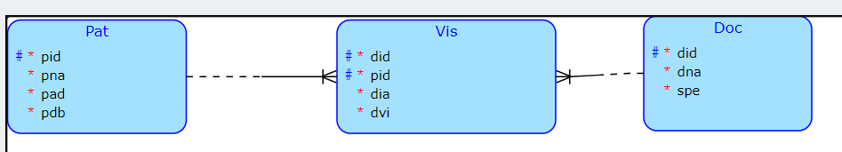
Solutions

Slide 7
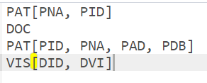
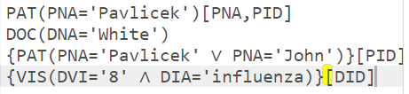
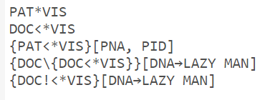
RA Solutions

